Slide 1
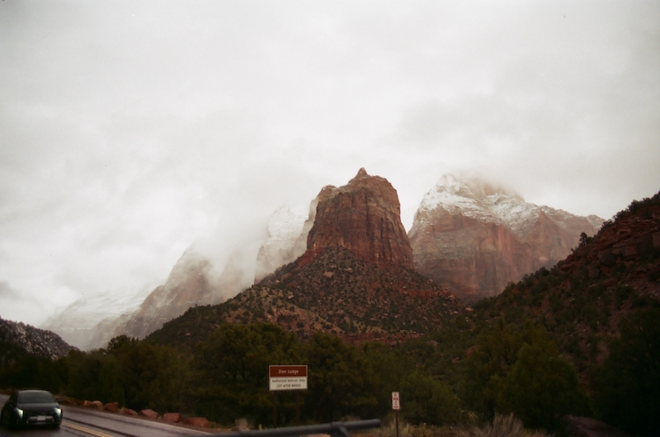
Zion Snow
Zion National Park , Utah
National Parks like Zion draw visitors from all over the world, and having a high visitor rate heavily impacts the land. The National Park Service works to mitigate these damages, but there is always an impact. For people to experience places like Zion, serious infrastructure has to be in place. This film photograph was taken on the other side of a major tunnel, which was a clever way to build a road through the Park without too much disruption to the land. However, roads and tunnels also affect local wildlife, so it is important to implement wildlife crossing structures. Utah is known for its dry climate where water is an increasingly rarer resource, and snowpack plays a critical role in river levels. As climate change worsens, the winter season gets shorter which means less snowpack. Less snowpack means more drought and more potential for wildfires. In the future, more mitigation measures will be needed to conserve resources and beauty.

Slide 2
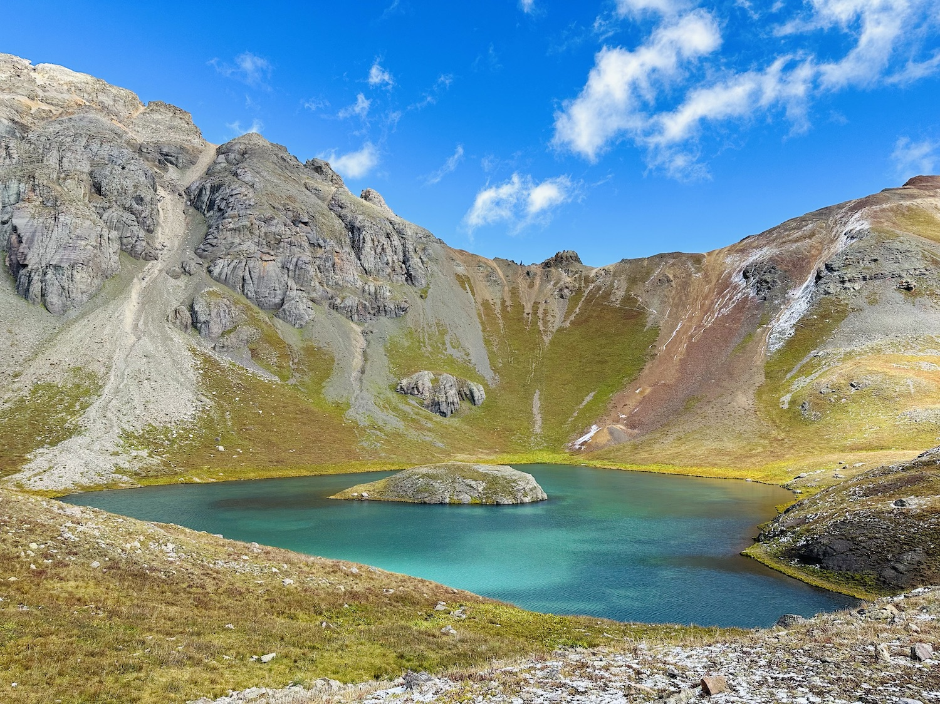
Ice Lake
San Juan Mountains, Colorado
This photo was taken after a long morning hike in the San Juan Mountains at a lake known as Island Lake, outside of Silverton, Colorado. Enduring the hours of hiking, miles away from civilization, served as a remarkable reminder of the abundance of untouched, vibrant landscapes that exist in the Western United States. It instilled in me a profound sense of gratitude for the continued existence of such pristine natural spaces. The breathtaking beauty of Island Lake underscores the urgent need for conservation; however, protecting places like the San Juan Mountain Range is vital for preserving these treasures for future generations to cherish and explore.

Slide 3
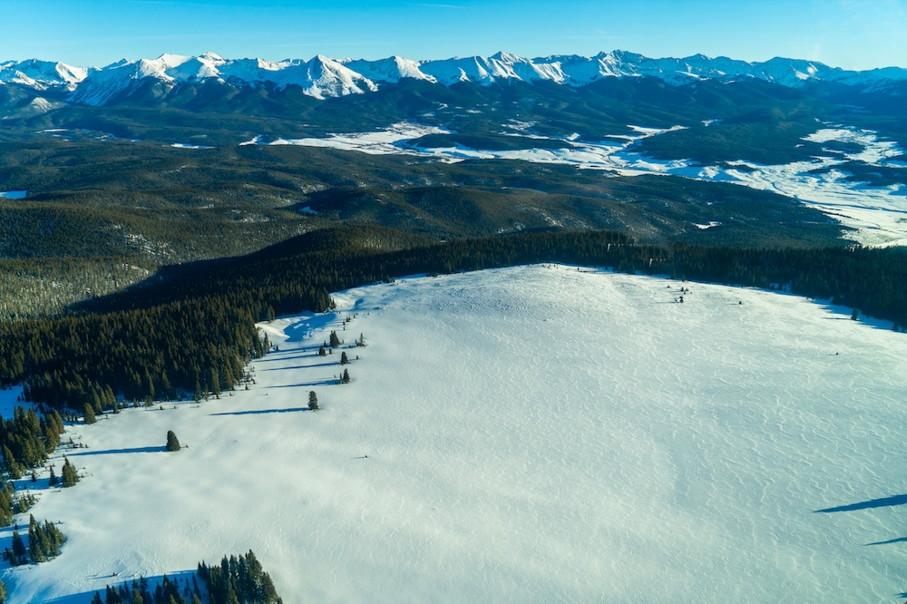
Winter Meadow
Gunnison National Forest, Colorado
This aerial photo was taken from a small plane above Gunnison National Forest. The Gunnison National Forest lies within the traditional territory of several Ute tribes, including the Ute Mountain Ute, Southern Ute, and Northern Ute Tribe. European colonization dispossessed these tribes from their ancestral lands, forcing them onto reservations far from the forests they relied on for hunting, fishing, and cultural practices. This displacement continues to impact these communities today.

Slide 4
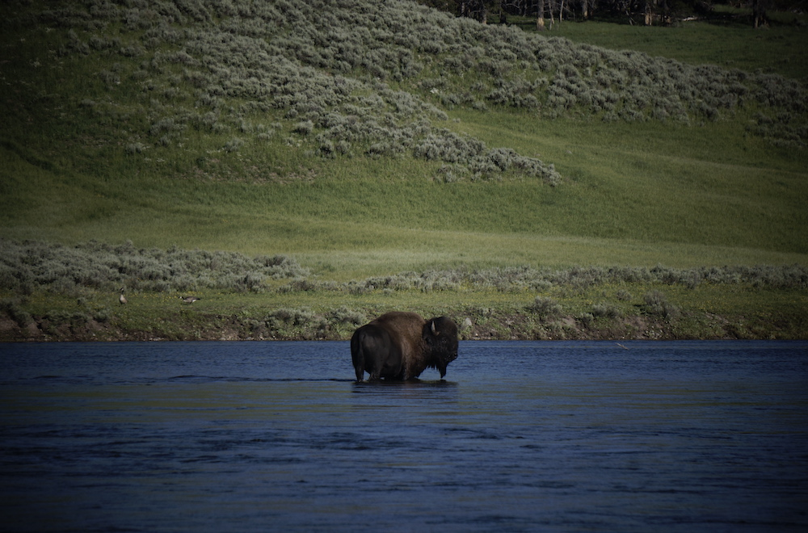
Lone Bison
Yellowstone National Park, Wyoming
A lone bison crosses the Yellowstone River in Yellowstone National Park. The Yellowstone River remains the longest undammed river in the US. The Yellowstone River and its ecosystem are shining examples of successful conservation efforts in the US. Bison populations were almost hunted to extinction, in 1884 there were as few as 325. Today, bison populations have recovered massively and continue to make a comeback. While populations are still far from original numbers, bison serve as an example of what can be recovered with concerted and thoughtful conservation efforts.

Slide 5
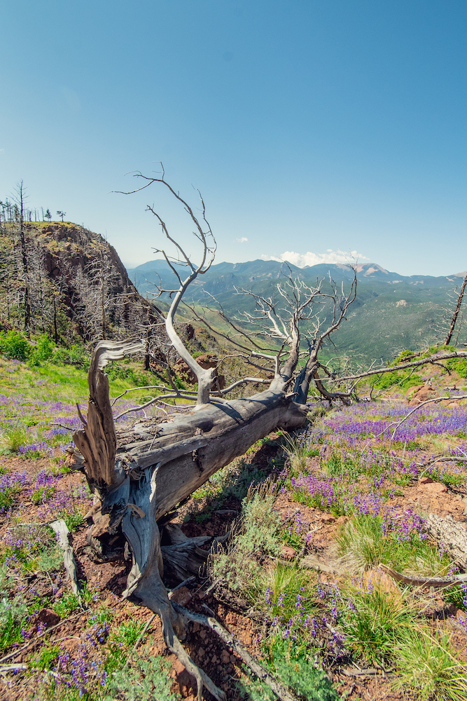
Fallen Forest
Waldo Canyon, Colorado
While the regrowth of grass and flowers after a wildfire may seem promising, the dominance of certain species can threaten biodiversity and ecosystem resilience. Here, amidst a fallen tree's remnants, the unchecked proliferation of shrubs could disrupt the delicate balance of the forest, highlighting the complex challenges of post-fire recovery. As climate change drives up wildfire burn severity, the likelihood of diverse ecosystem regrowth diminishes.

Slide 6
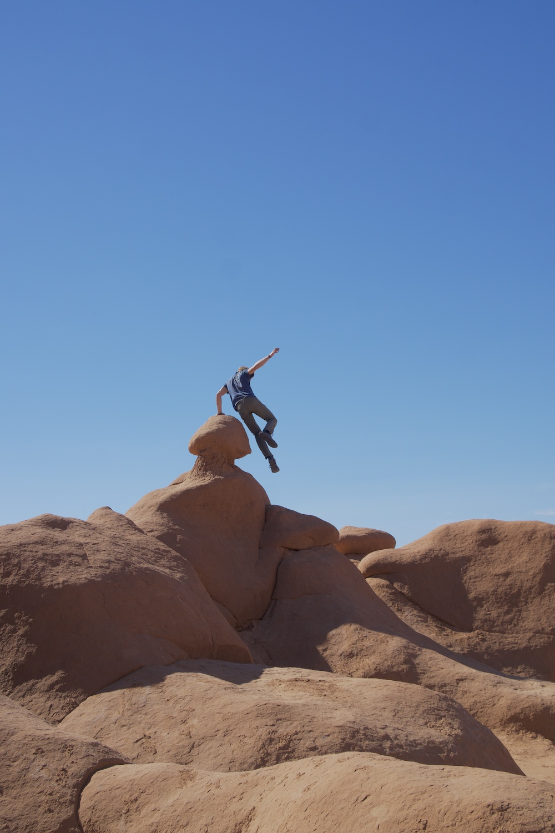
This past fall, my camera and I captured a juxtaposition that speaks to one of the great dilemmas of our times. Through these images taken in the heart of Goblin State Park, I seek to illuminate the dance between humanity and wilderness. Our presence can at times seem intrusive, especially in dramatic and untouched landscapes, so as stewards, it is important to navigate the fine line between preservation and access. These photographs encourage reflection on our role as outdoorspeople, prompting us to consider how we can both enjoy and explore our natural world, while preserving its beauty for generations to come.
Mushroom Rock
Goblin State Park, Utah

Slide 7
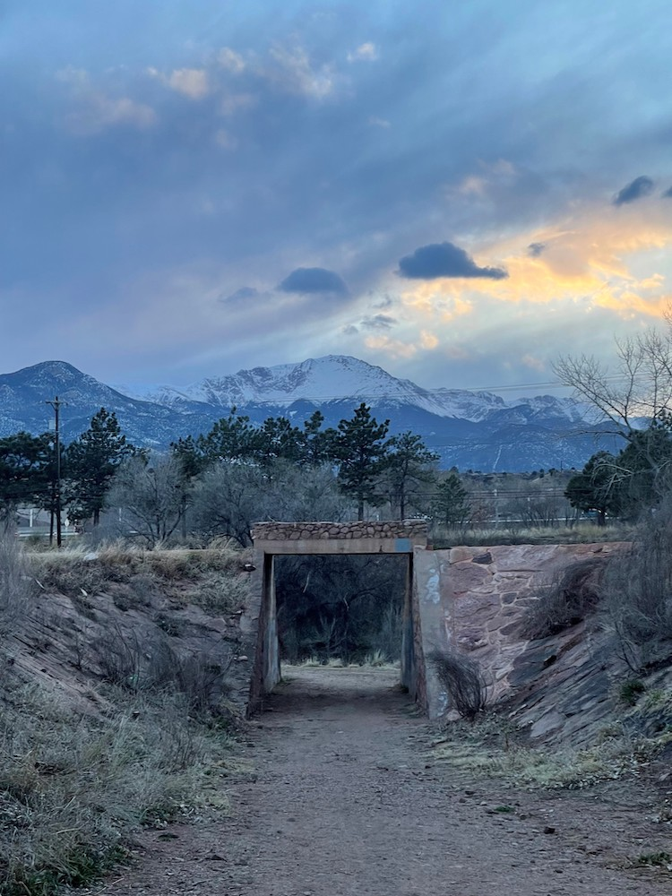
Monument Trail
Colorado Springs, Colorado
This photo was taken on the local ‘Tiger Trail’ or the Monument Creek trail. Being so close to the city but still having a sense of natural beauty is the vision that city planners kept in mind while creating living spaces. The picture shows a man-made tunnel that supports the trail above as well as telephone poles in the background. To keep the vision of beautiful natural areas around living spaces, we must commit to preservation of vegetation, waterways, etc.

Slide 8
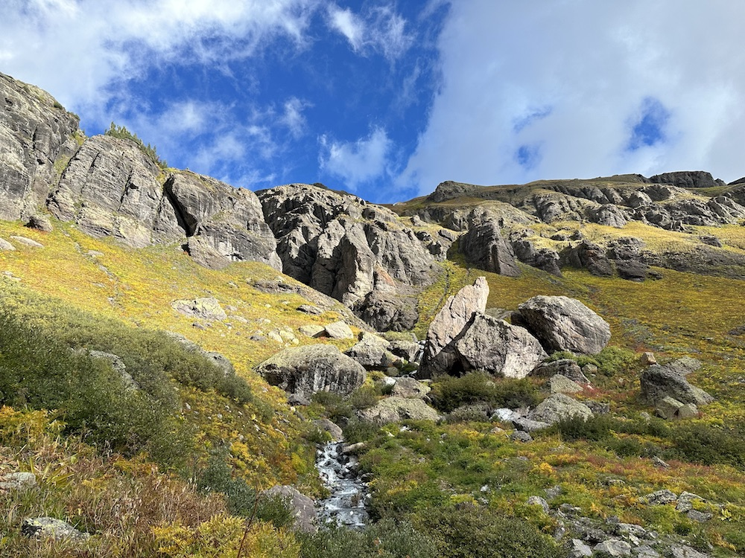
Ice Lake Basin
San Juan Mountains, Colorado
In this captivating snapshot during a hike up the Ice Lake Basin, we stopped to gaze upwards, enveloped in the undisturbed magnificence of the San Juan Mountains. Towering rocks allow for a stream of water to cross our path, while vibrant wildflowers dance from the trail's edge up to the mountain peaks. It served as a beautiful reminder to pause along the demanding journey, to admire the different perspectives the Colorado West provides, and to remember that the journey is just as beautiful as the destination. As we marvel at the brilliance captured in this moment, we're prompted to safeguard these pristine landscapes, ensuring that their beauty endures beyond our fleeting footsteps.

Slide 9
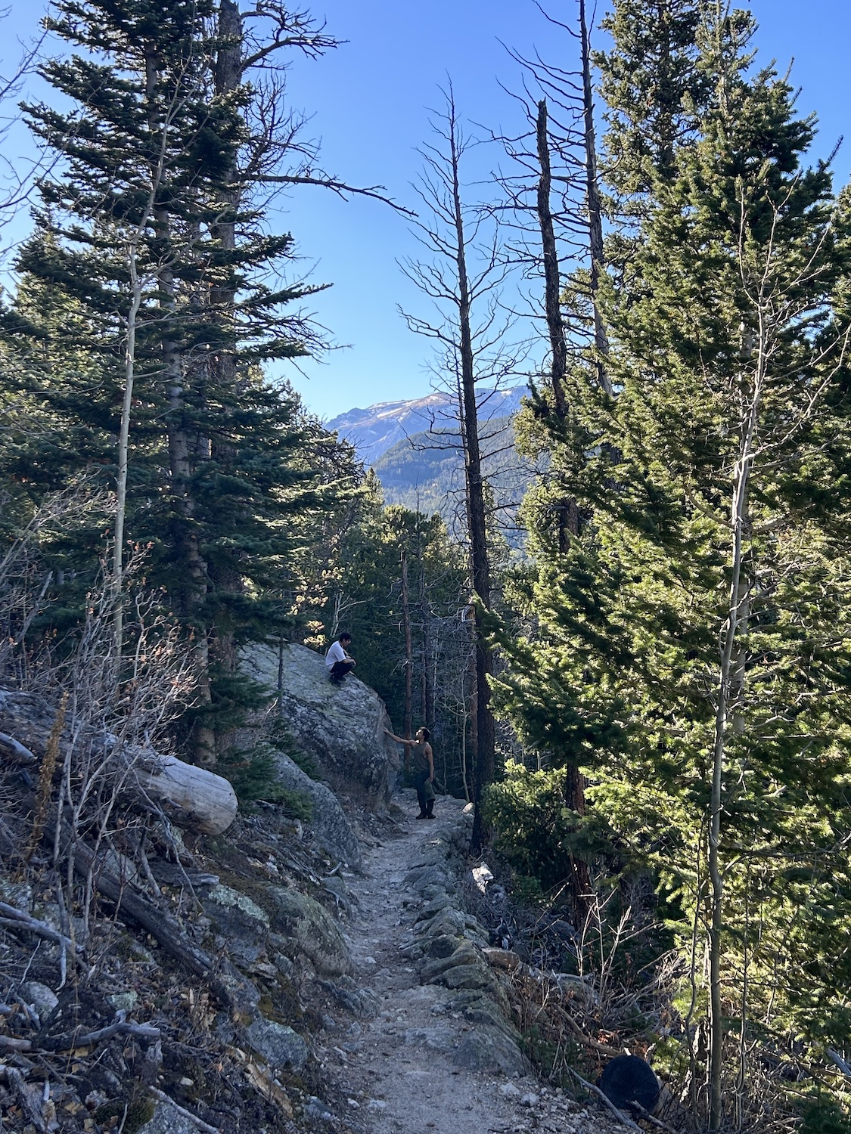
Lend a Hand
Rocky Mountain National Park, Colorado
In spite of looming deadlines, tests to study for, internships to apply for, and jobs, students swarm out of Colorado College on the weekends to pursue the call of the mountains. The allure of the national parks might seem trivial at first, yet, when students return to campus, there is a new energy about them. Despite weary eyes from a long day in the car, students are a greater peace of mind from their peregrination. The enticing mountains serve students as a place to escape from the weight of academic life and be introspective, finding inner peace. Similar to Colorado College students, 93% of Westerns believe that seeing nature aids mental health. Mental health support doesn’t just mean therapy and pills, but also a space to be at peace. Students embody this, venturing out to take a break, climb a rock, lend a friend a hand, and relax.

Slide 10
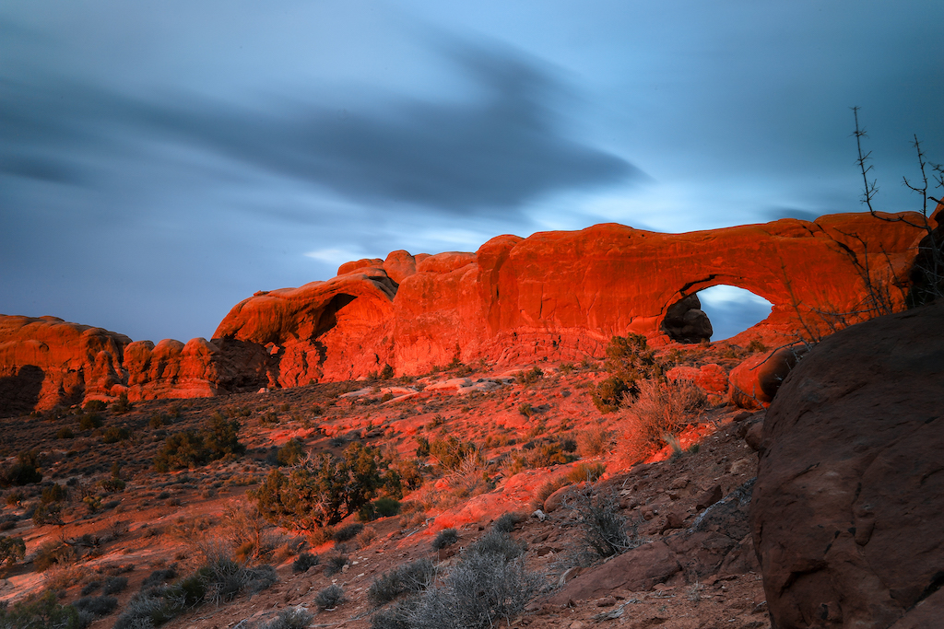
A Blue Eye in the Red Desert
Utah
Rainstorms in the desert are far and few between, yet the few that do periodically drench the landscape provide enough moisture to support the flora and fauna endemic to the Utah desert. Earlier in the day, a storm passed overhead, and by the time the sun shone between the horizon and the receding clouds, the biological soil crust had already soaked up the moisture – moisture essential for the spring blossoming that I missed probably by only a few weeks.

Slide 11
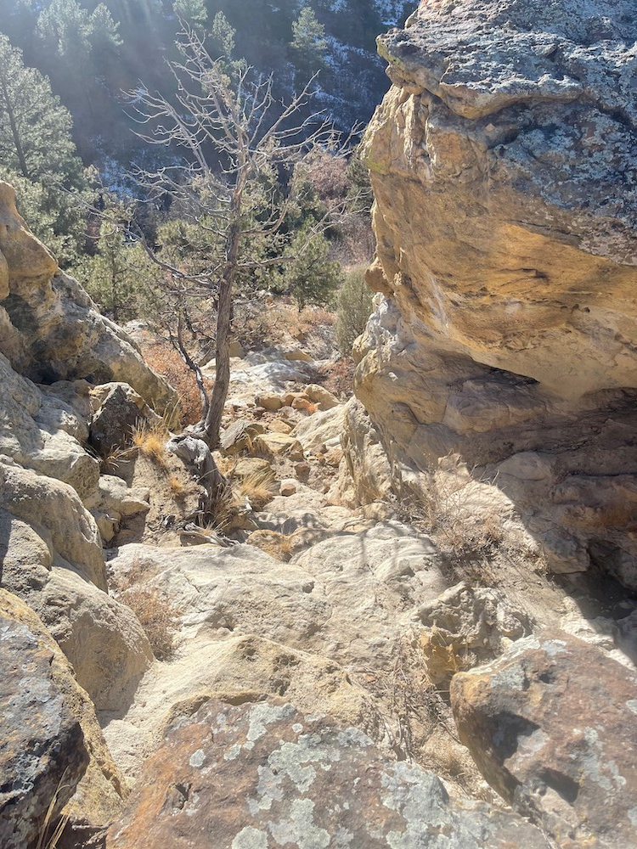
Palmer Park
Colorado Springs, Colorado
This picture was taken on a trail in Palmer Park- a free park that is packed with hikers, dog walkers, cyclists and many more. Conservation of entire environment includes our public parks and protecting the enjoyment of nature for us and future generations. We want to be able to share the same spaces with our children and communities. These spaces might look different in 30 years, but conservation is about protecting both the lives of future generations and the spirit of our natural spaces.

Slide 12
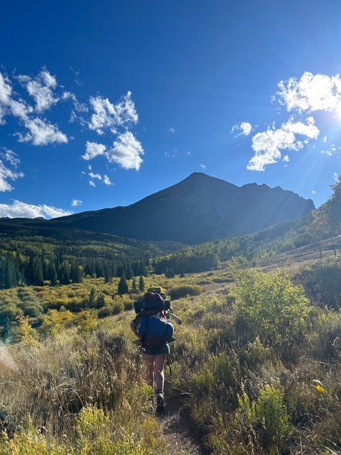
To the Mountain
Silverthorne, Colorado
Eagle’s Nest Wilderness is a US Wilderness Area in Colorado. Home to the Gore Mountain Range, these mountains contribute essential water to the Colorado River every year. The protected area provides a home to many animals, and beautiful, quiet hiking to lucky humans.

Slide 13
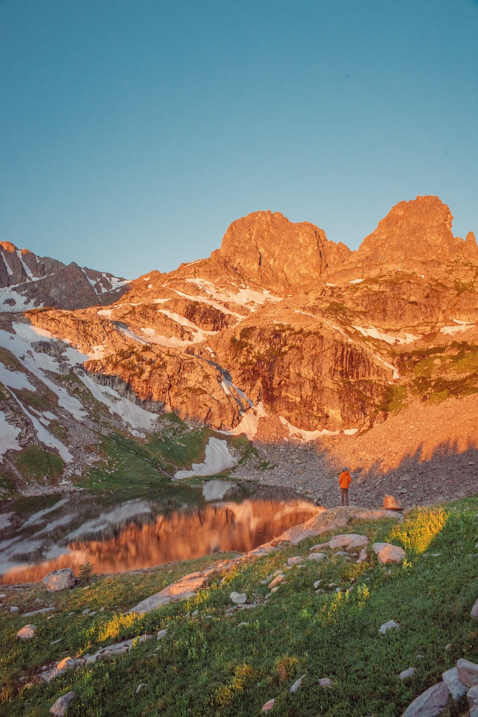
Sunrise at Willow Lake
Eagles Nest Wilderness, Colorado
First light hits the Gore range on a chilly July morning, reflecting orange light onto the alpine lake below. Situated high in the Rocky Mountain, alpine lakes such as this serve as nature's water reservoirs. These pristine bodies of water not only provide scenic beauty but also act as crucial sources of freshwater: sustaining ecosystems downstream and supplying communities with clean water. Preserving these alpine treasures is essential for maintaining water security and ecological balance in the Rocky Mountain West. With yearly snowmelt decreasing, these natural reservoirs are becoming increasingly threatened.
To VOTE for this photo Text
WILLOW LAKE to:
(719) 624 - 4979

Slide 14
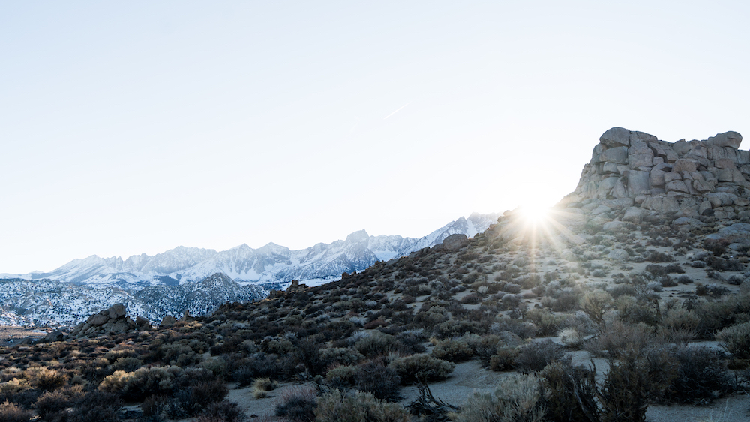
Evening Light
Rocky Mountain National Park,
Colorado
This photo was taken near Buena Vista in the Rocky Mountain National Park: The soft evening light glancing off the side of the rock gives warmth to this cold landscape during winter. Droughts in Rocky Mountain National Park threaten the health of the ecosystem, reducing water for plants and animals and increasing the risk of wildfires. This can lead to wildflower blooms failing, stressed wildlife populations, and a landscape more vulnerable to flames.

Slide 15
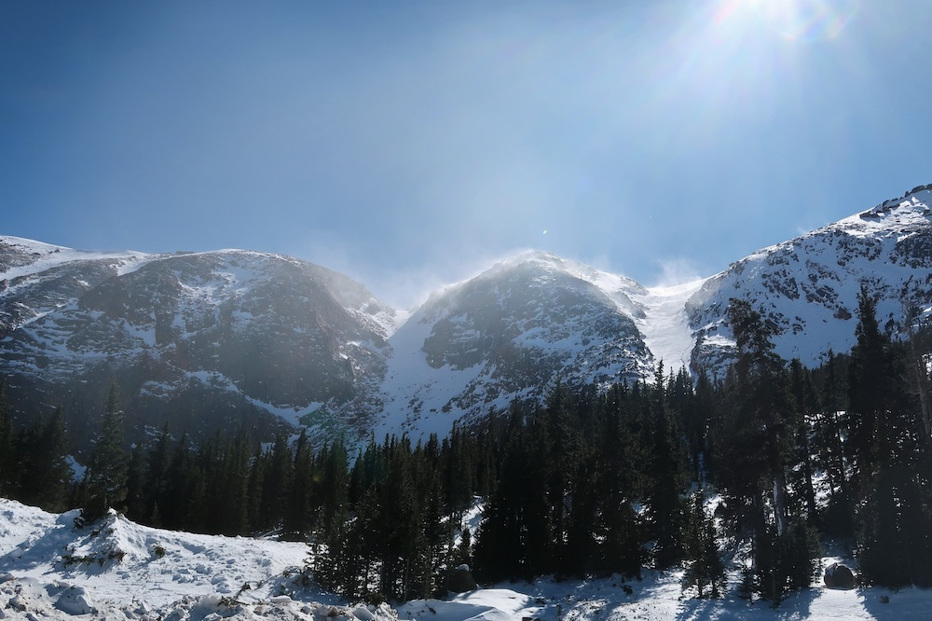
Pikes Peak Highway
Colorado
The image captured along the Pikes Peak Highway encapsulates the sublime beauty of the Colorado landscape. Towering peaks adorned with lush forests and violent winds create a mesmerizing scene. However, amidst this awe-inspiring panorama lies a reminder of the importance of conservation. The ascent of Colorado's Pikes Peak, a renowned 14er, has undergone significant commercialization over the years. What was once solely a rugged wilderness experience has been transformed into a tourist attraction accessible via the Pikes Peak Highway and the cog railway. Souvenir shops, snack stands, and other commercial ventures now line the route. While these amenities enhance accessibility for some, they also detract from the raw, untouched nature of the mountain experience. The commercialization of Pikes Peak serves as a reminder of the delicate balance between promoting tourism and preserving the integrity of our natural landscapes.

Slide 16
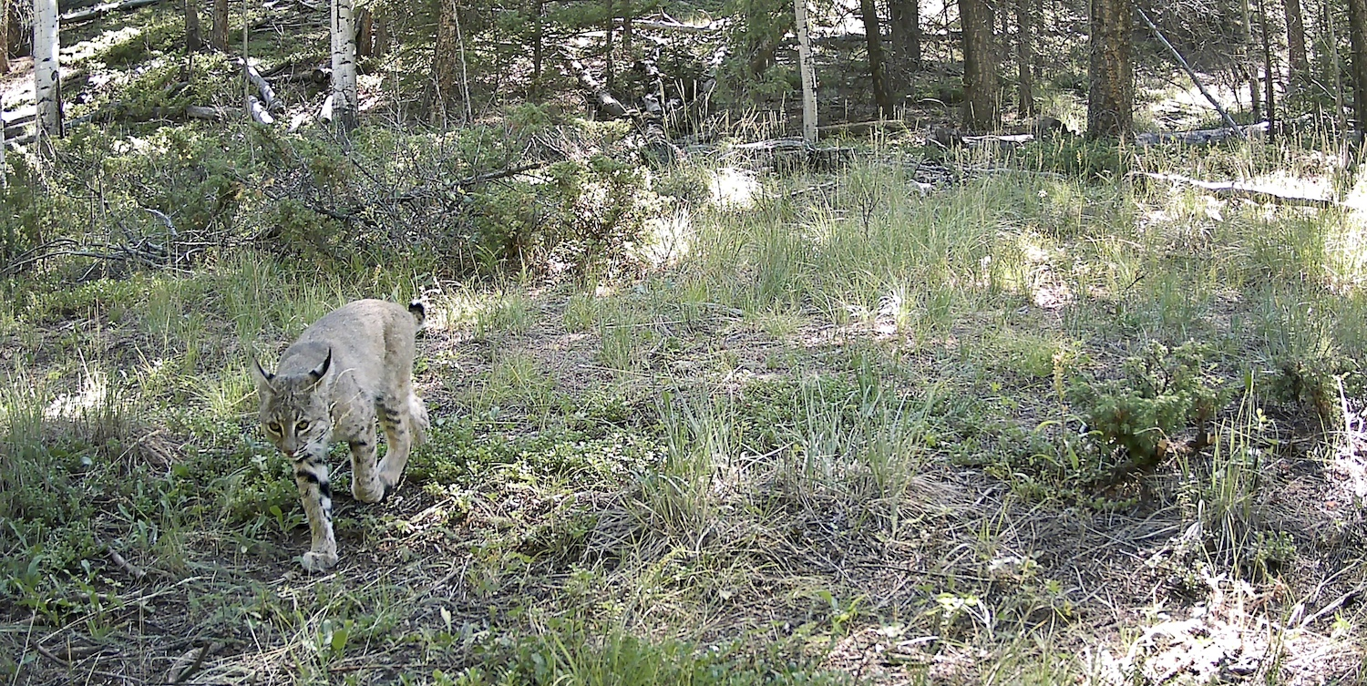
Bobcat
Rocky Mountains,
Colorado
I photographed this bobcat with a camera trap as part of my research on the impacts of human activity on carnivores in Colorado. Bobcats and other wildlife species are threatened by human development and especially by habitat fragmentation and mortality risk associated with roads. 85% of Westerners in the State of the Rockies survey supported constructing wildlife crossings, which are essential for the conservation of highly mobile wildlife species with large territories like bobcats.

Slide 17
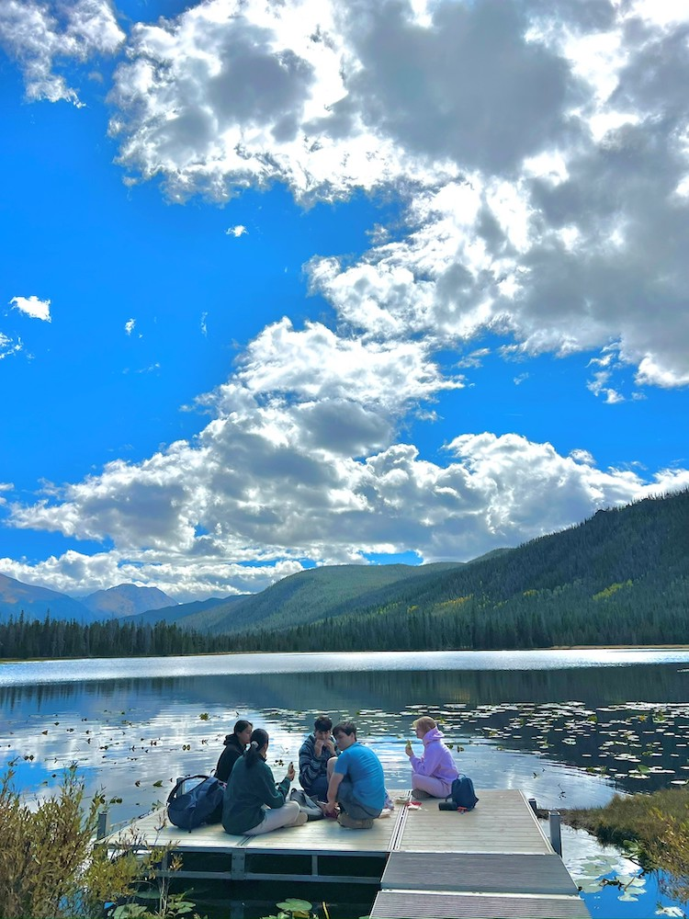
Strawberry Lake
Grand Lake, Colorado
This image is of a block break trip in the Grand Lake area. Specifically with the picture, I wanted to touch on the importance of water conservation in Colorado. Strawberry Lake is a hidden reservoir about a 3-mile hike from the Arapaho National Forest road. While this water source is mostly untouched, it is a meeting ground for many animals, plants, and human communities.
Water is piped all along the front range as we don’t have many natural water sources in Colorado- at least not any that can sustain the exponentially growing population of Colorado. Water conservation takes into account both the protection of natural water sources for human enjoyment and wildlife sustainment as well as the treatment and returning of water into the water cycle.

Slide 18
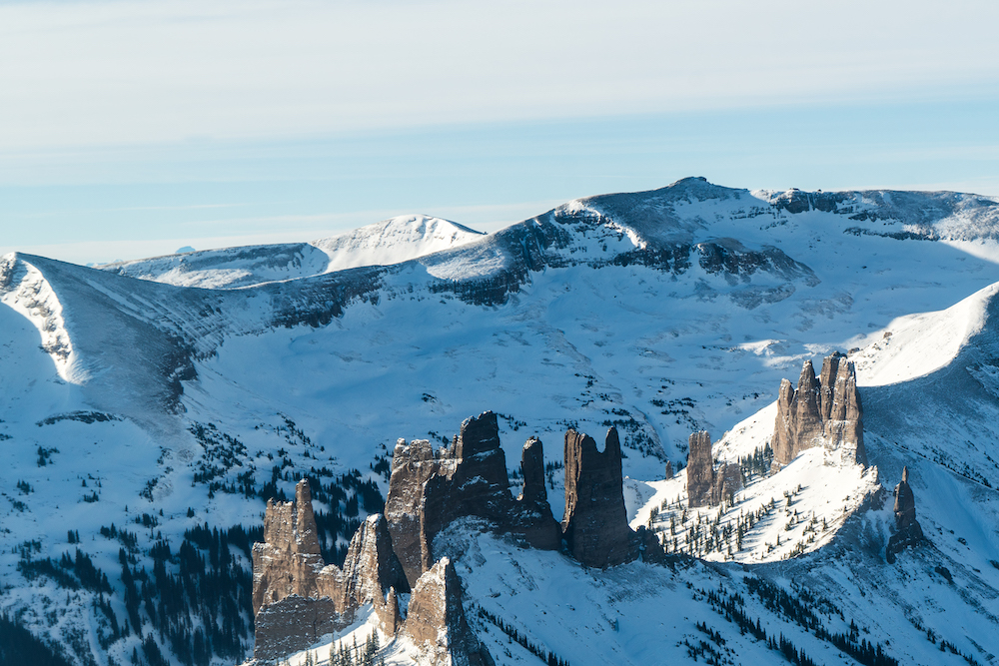
The Castles
Mill Creek Canyon, Colorado
This photo was taken up Mill Creek Canyon near Gunnison and depicts large towering rock spires known as "The Castles." This photo presents a harsh landscape, filled with rigid mountain horizons and cold shadowy valleys of the White River National Forest. This area has experienced intense episodic drought and lowered water tables since 2002, and climate change has been decreasing the snowfall in this region almost every year.

Slide 19
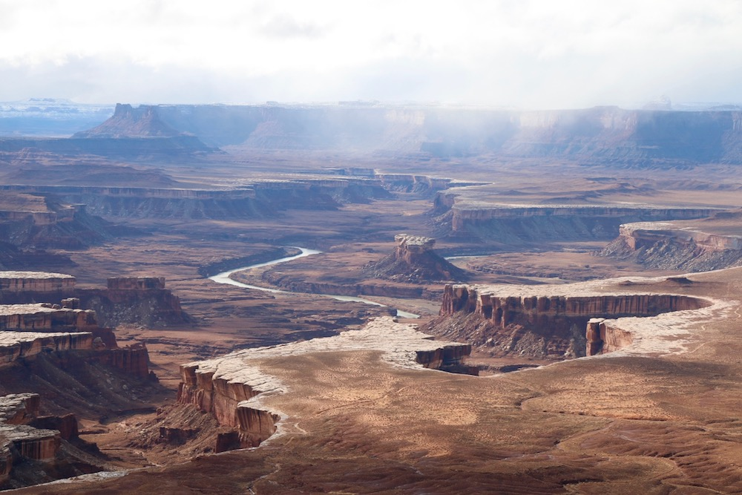
Other-Worldly Landscape
Canyonlands, Utah
An ethereal haze settles over an other-worldly landscape while the Colorado River continues its five-million-year journey, cutting its way deeper and deeper into the Earth. As with many other waterways, due to climate change and seemingly insatiable human demand, the Colorado recedes every year. Future generations may not have the privilege of experiencing this awe-inspiring view if this continues unabated. Canyonlands would lose one of its incredible scenes.

Slide 20
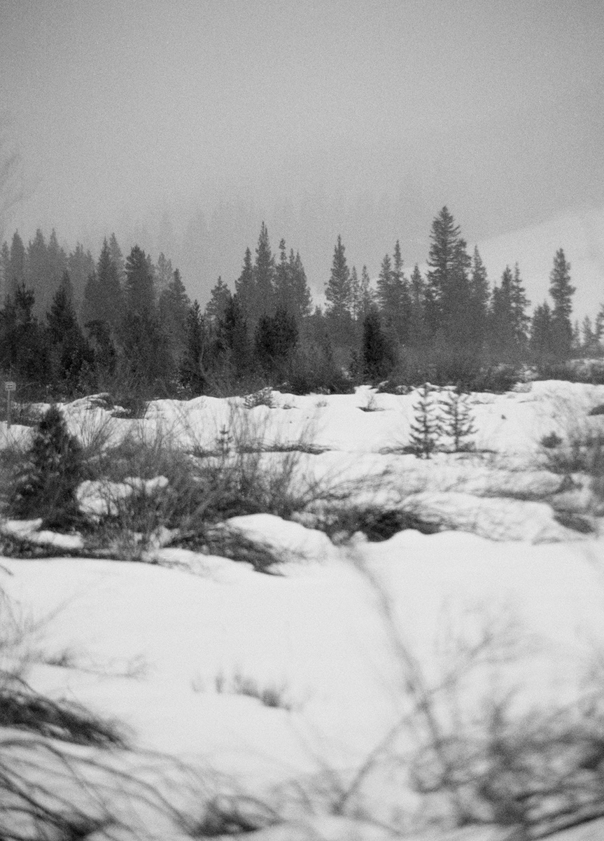
Up-Valley Breeze
Crested Butte, Colorado
An early-season snowstorm slowly moves its way up-valley, adding to the integral accumulation of snow across the state – snow that will ultimately go on to refresh the rivers, lakes, and aquifers of the Western United States. Continuous snowfall from October to April in high alpine stream valleys ensures that these reservoirs can continue to sustain our communities as well as the vast ecosystems that surround us.

Slide 21
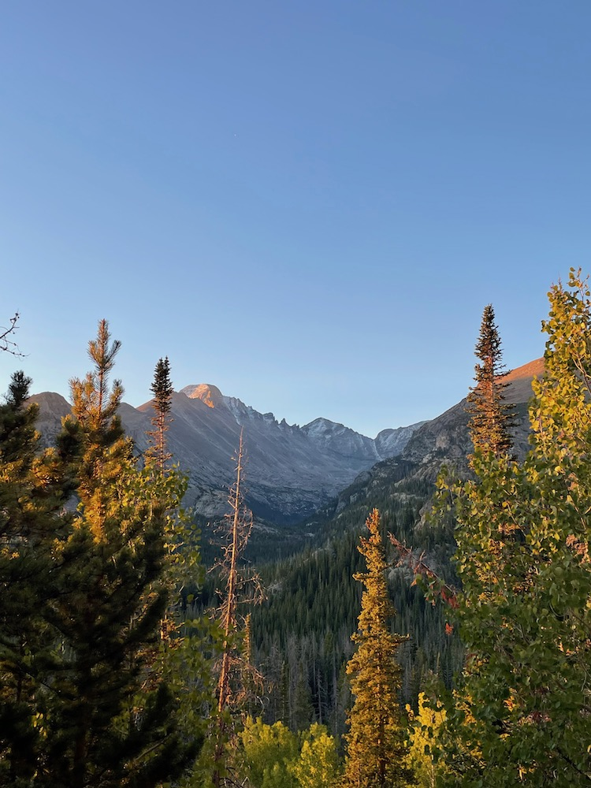
Morning Glow
Rocky Mountains, Colorado
The Rocky Mountains are perfectly positioned between conifers as the sun rises on my morning hike. This beautiful view is something I never experienced, having lived my entire life in Washington D.C. The serenity I feel in moments like these increases my deep appreciation for the conservation of the Rockies. Each acre preserved is a testament to our commitment to future generations, ensuring they too can experience the tranquility of this untouched wilderness.

Slide 22
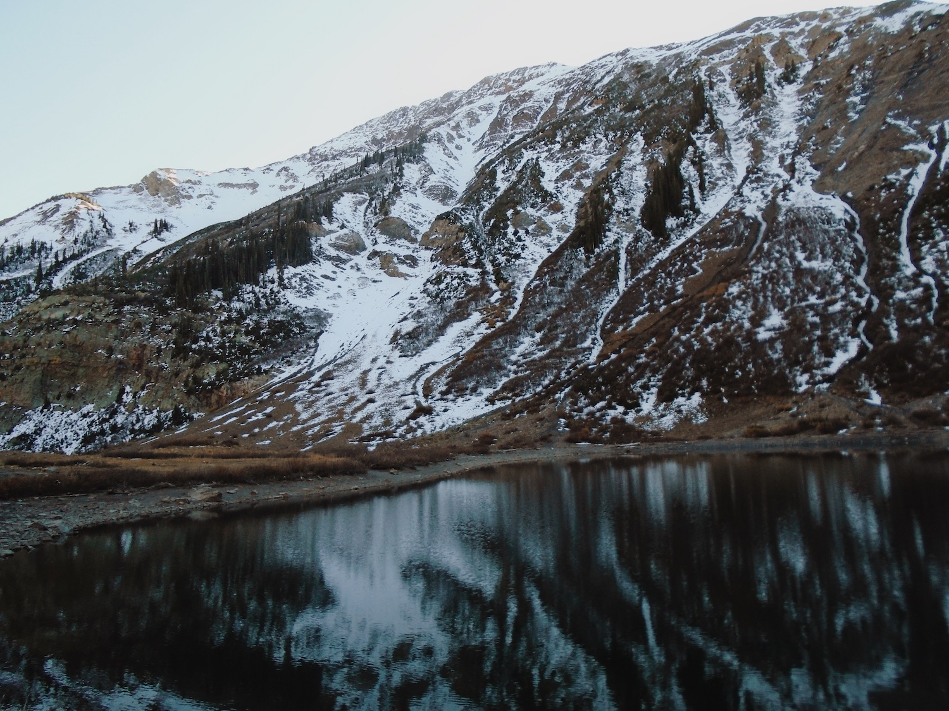
Snow Pack
Crested Butte, Colorado
In this lake outside of Crested Butte, snowpack feeds the water. But what if the snow is gone? Water is the resource of the living. But it continues to dwindle as climate change causes snowpack and water levels to decrease. Preserving our existing water sources and taking measures to prevent future loss is essential.

Slide 23
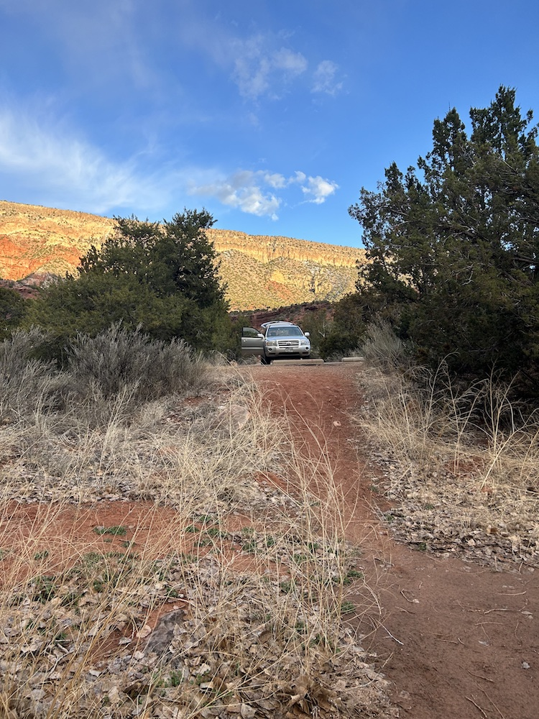
Turn Around, You Are Here As Well
Rio Grande and Conejos Rivers, New Mexico
Westerners love the idea of an untouched wilderness, distant from the impacts of mankind. The rugged, pure, untouched beauty of national parks is an ideal that isn’t realistic. The Rio Grande and Conejos are both major rivers that hold immense beauty and vital habitats that Coloradans and New Mexicans love. Recreation along these rivers is easily accessible by the major roads paralleling them leading to easy access, leading to the impressively high 88% of westerns who have visited national public lands in the last year. The ability to just turn off into a place for recreation is incredible, yet with ready public access comes public responsibility to take care of the land they love to use. It is important to recognize that we are amidst and part of the land. When looking out at the beautiful peaks, it's important to turn around, and remember to do your part in preservation.
To VOTE for this photo Text TURN AROUND to: (719) 624 - 4979

Slide 24
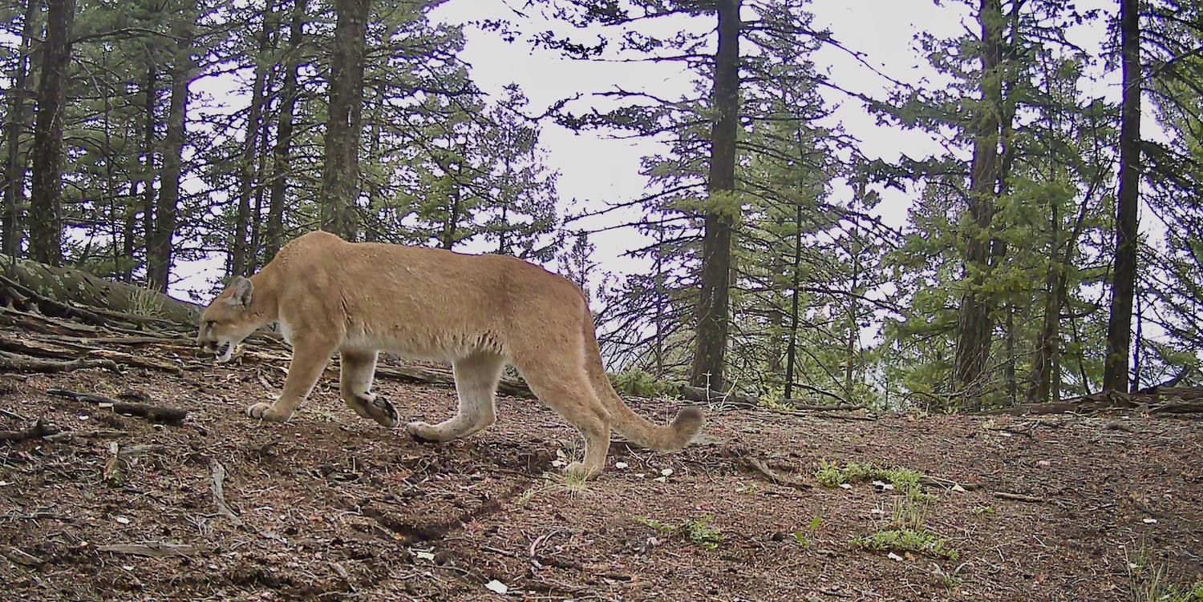
Mountain Lion
Rocky Mountains,
Colorado
I photographed this mountain lion with a camera trap as part of my research on the impacts of human activity on carnivores in Colorado. Human land use can negatively affect wildlife by changing their behavior or by contributing to habitat fragmentation. I found that mountains lions were less likely to use sites with high road density than those with less road disturbance, underscoring how important conservation of wildlife corridors and the creation of highway underpasses are for wildlife in the Southwest. The State of The Rockies survey found that 78% of Westerners believe that emphasis should be placed on conserving wildlife migration routes than on economically productive land uses, so many Westerners recognize and are in support of conservation action for species like mountain lions.

Slide 25
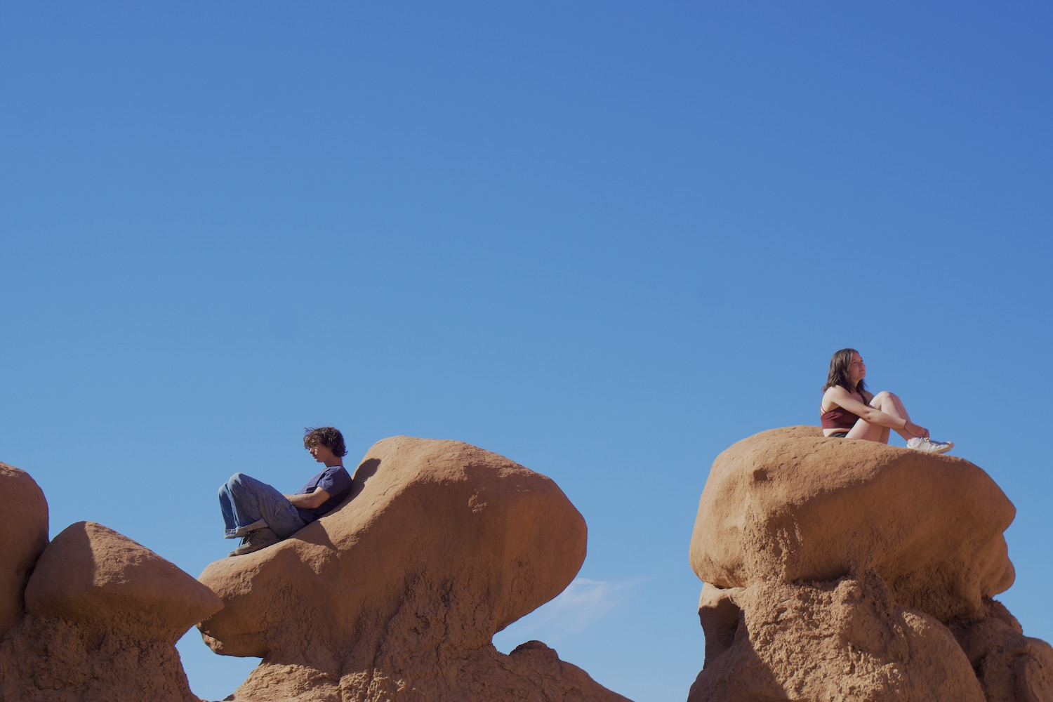
Natures Embrace
Goblin State Park, Utah
This image explores how nature can rejuvenate and act as a safe haven for people to think and reflect in. The pillowy formations that surround the figure exemplify nature's embrace and healing power which is vital to many people's mental and physical health. With these thoughts in mind, this image aims to question how we can both increase access to these healing spaces while also keeping them quiet and peaceful for those who already enjoy them.

Slide 26
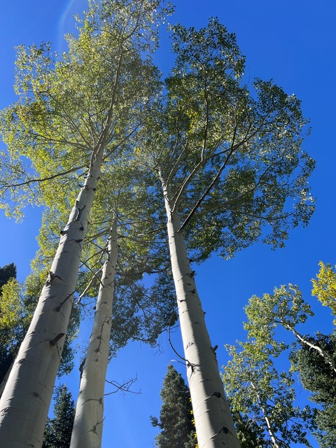
The Three Sisters
Silverthorne, Colorado
Eagle’s Nest Wilderness is a US Wilderness Area in Colorado. During Autumn, the hills full of Aspen turn a brilliant yellow. These three are in the midst of their transformation. Home to the Gore Mountain Range, these mountains contribute essential water to the Colorado River every year. The protected area provides a home to many animals, and beautiful, quiet hiking to lucky humans.

Slide 27
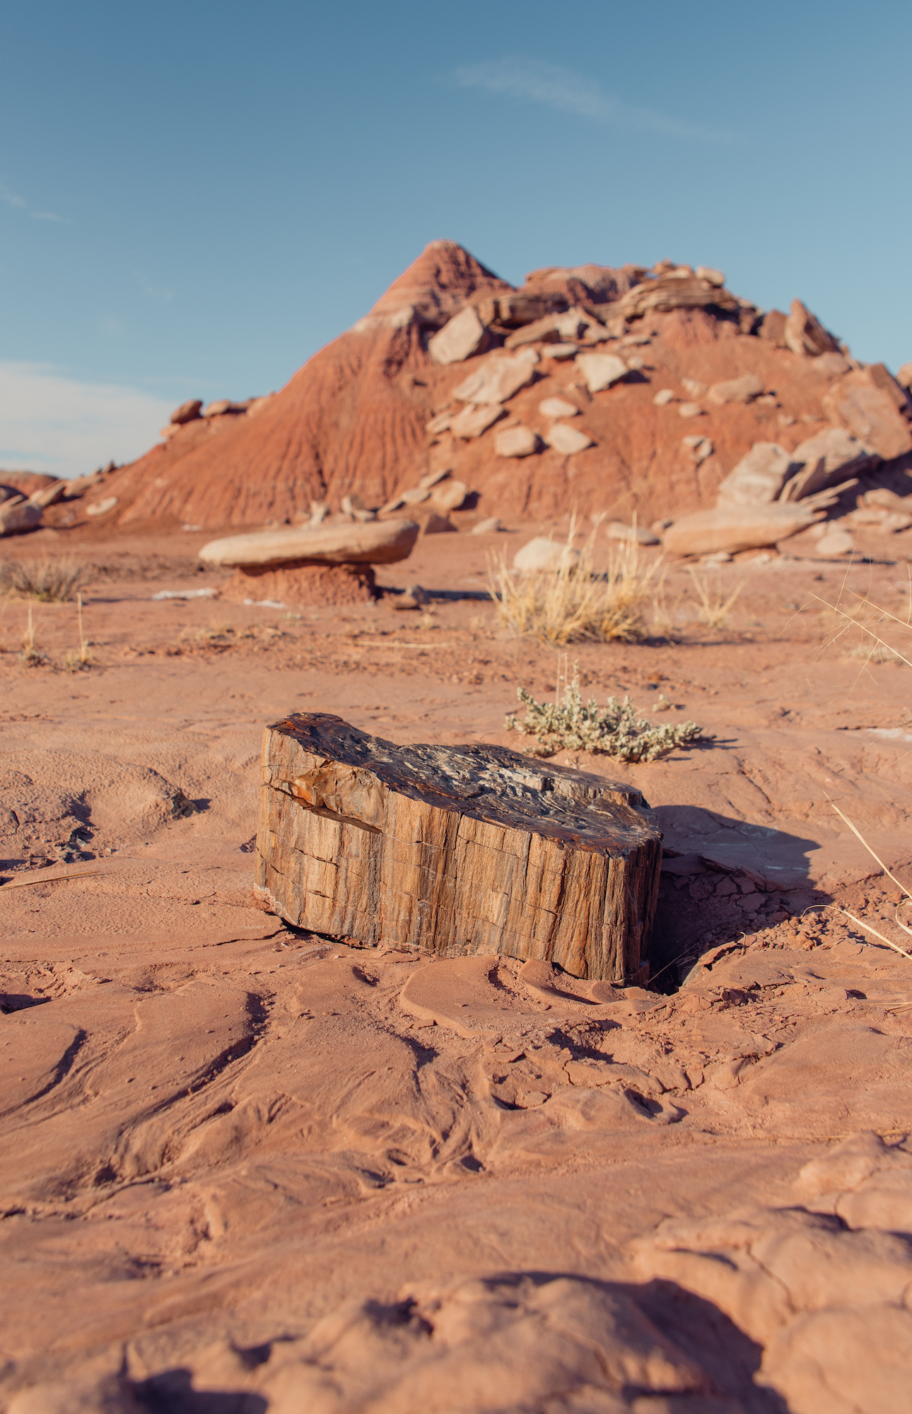
Fossilized
Petrified Forest National Park, Arizona
Petrified Forest National Park stands as a timeless testament to the importance of protecting public lands. Here, ancient tree fossils speak to the distant past landscapes and climate of Northeast Arizona. This ability to look into the past reminds us of our duty to preserve natural wonders for future generations.

Slide 28
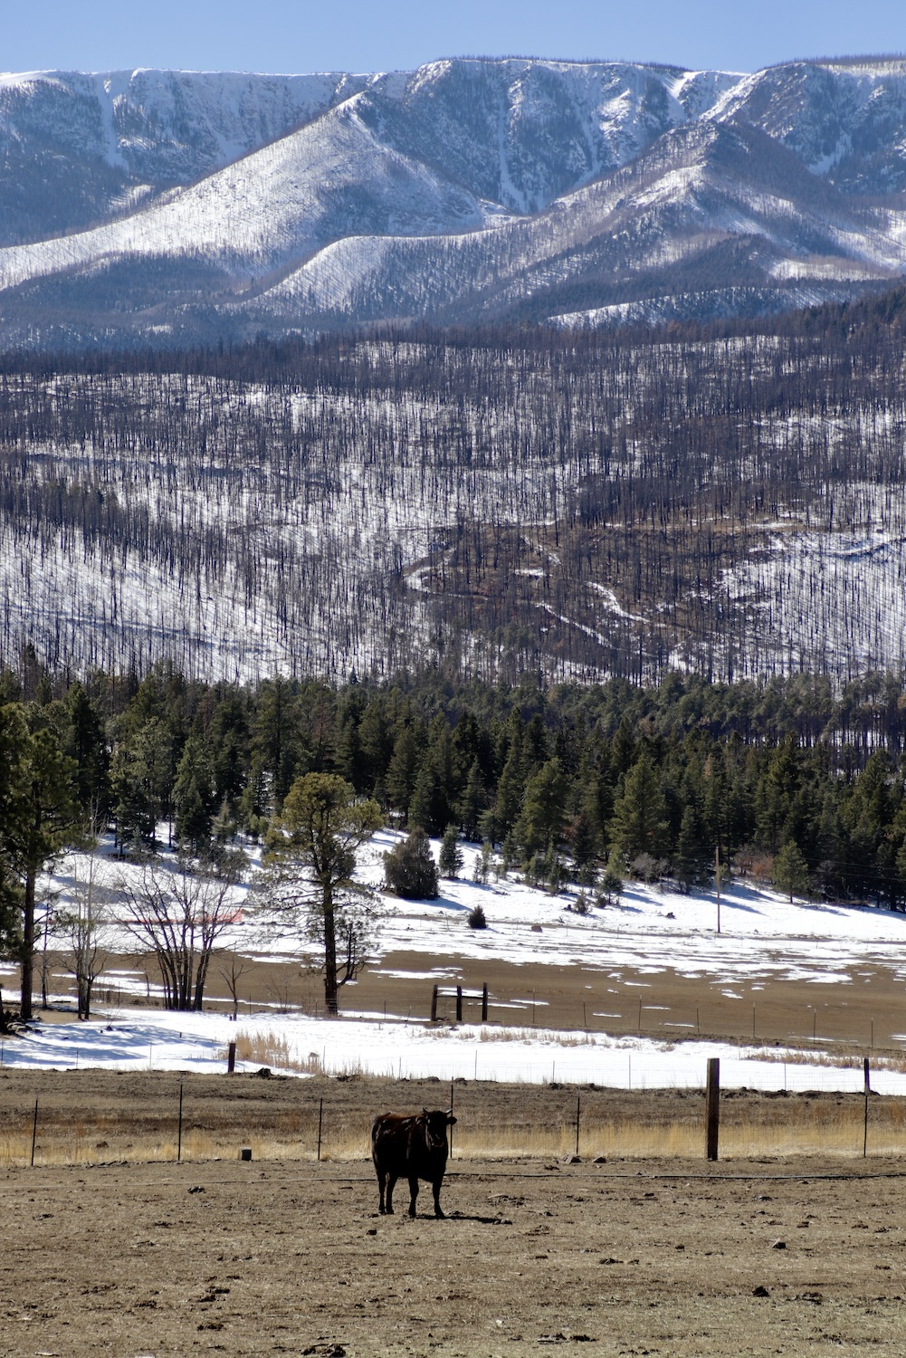
Forest/Ranch Border
Santa Fe National Forest, New Mexico
While protected lands across the west are safe from the effects of extractive/exploitative resource processes, mines, logging yards, and ranches butt up against these lands from every direction. Here, a cow in New Mexico looks from the land of it’s ranch while the protected lands of the Santa Fe National Forest dominate the background.

Slide 29
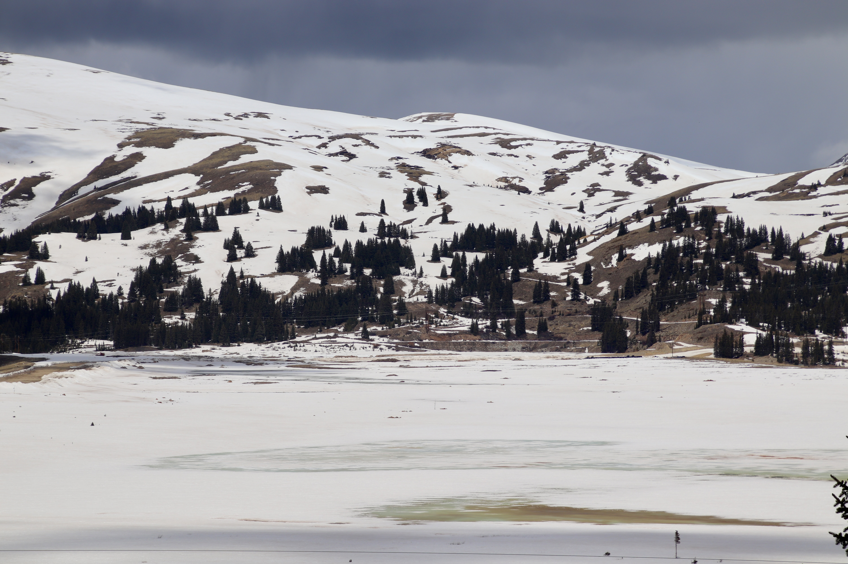
Leach Pit or Lake?
Fremont Pass, Colorado
Just north of Leadville, on Fremont Pass lies the Climax Molybdenum Mine. The strip mine is a gargantuan pit that has removed almost half of Bartlett Mountain, but further north in an unnamed valley lies the mine’s leach pit. In winter, the leach pit is hidden under a layer of ice and snow, appearing as a lake. But through holes in the ice, the corrosive chemicals filling the unnatural basin reveal their green and orange hues.

Slide 30
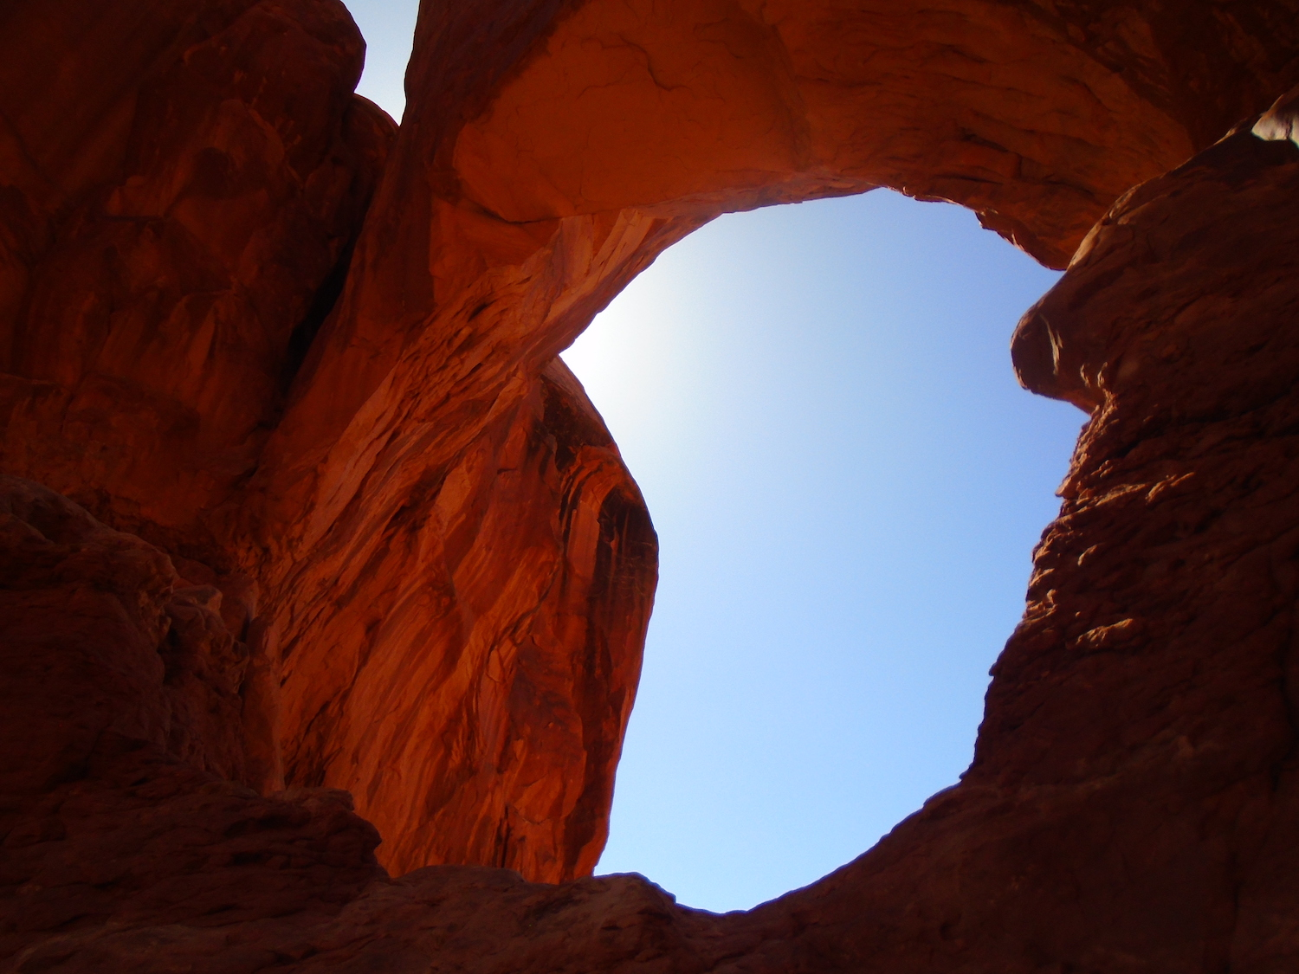
Double Arch
Arches National Park, Utah
Taken inside Arches National Park, this photo represents the desire of most Americans to preserve public lands. However, the Double Arch, as represented in the photo, to me shows the double standard of preserving stolen lands. Balancing conservation and preservation with the acknowledgement of past misdeeds in creating national parks is shown by the delicate equilibrium of the arch.

Slide 31
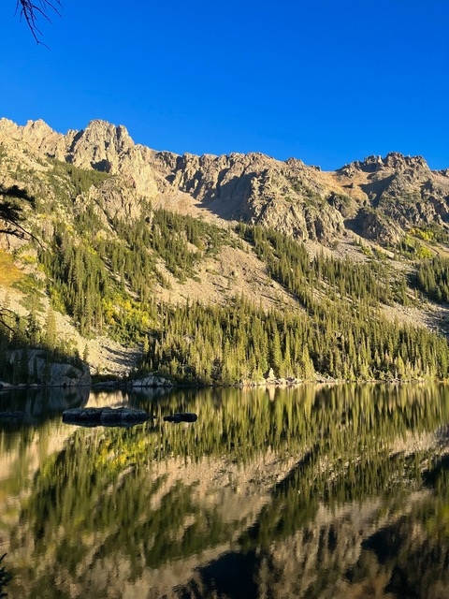
Morning Mirror
Silverthorne, Colorado
Eagle’s Nest Wilderness is a US Wilderness Area in Colorado home to the Gore Mountain Range. These mountains contribute essential water to the Colorado River every year. The protected area provides a home to many animals, and beautiful, quiet hiking to lucky humans.

Slide 32
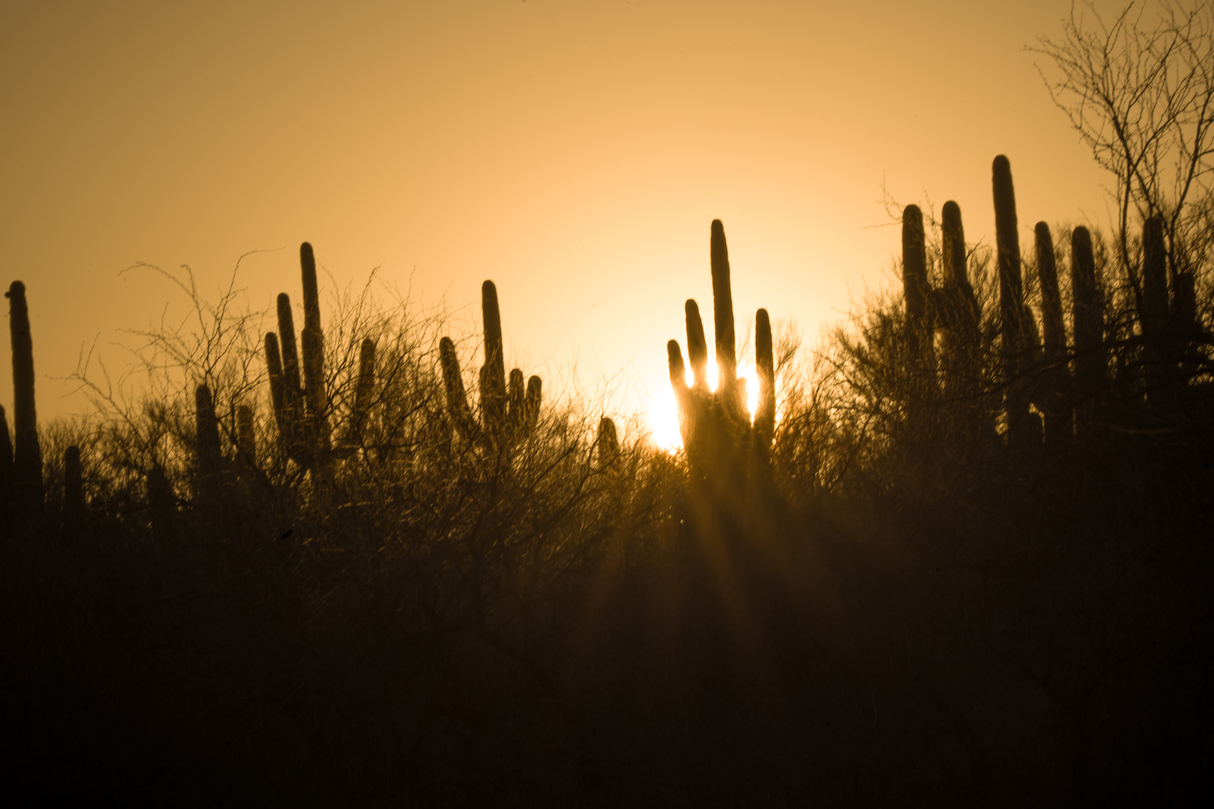
Catalina State Park
Arizona
Westerners recognized the importance of public lands for recreational opportunities, mental health benefits, and providing habitat for wildlife. This photo was taken in Catalina State Park just outside the major metropolitan area of Tucson, and is visited by over 250,000 people a year, highlighting the value of public land to Western communities.

Slide 33
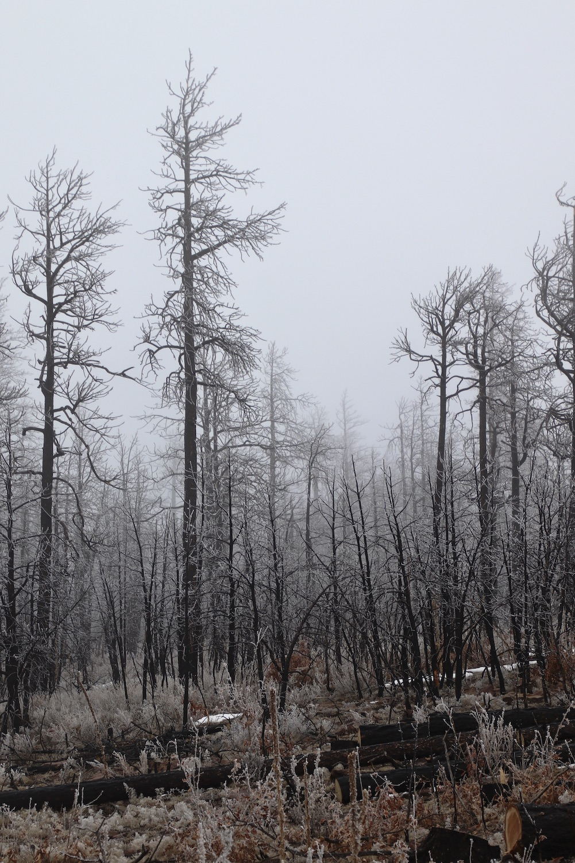
Snow on the Hermit’s Peak Burn Scar
New Mexico
The Hermit’s Peak fire tore through New Mexico’s national forests in 2023 after a controlled burn went wild, leaving swaths of torched trees across more than 500 acres of the state. As climate change continues to lead to drought increases in the west, fires like this will become more and more common, leaving animals without habitat and landowners to clean up the trees.

Slide 34
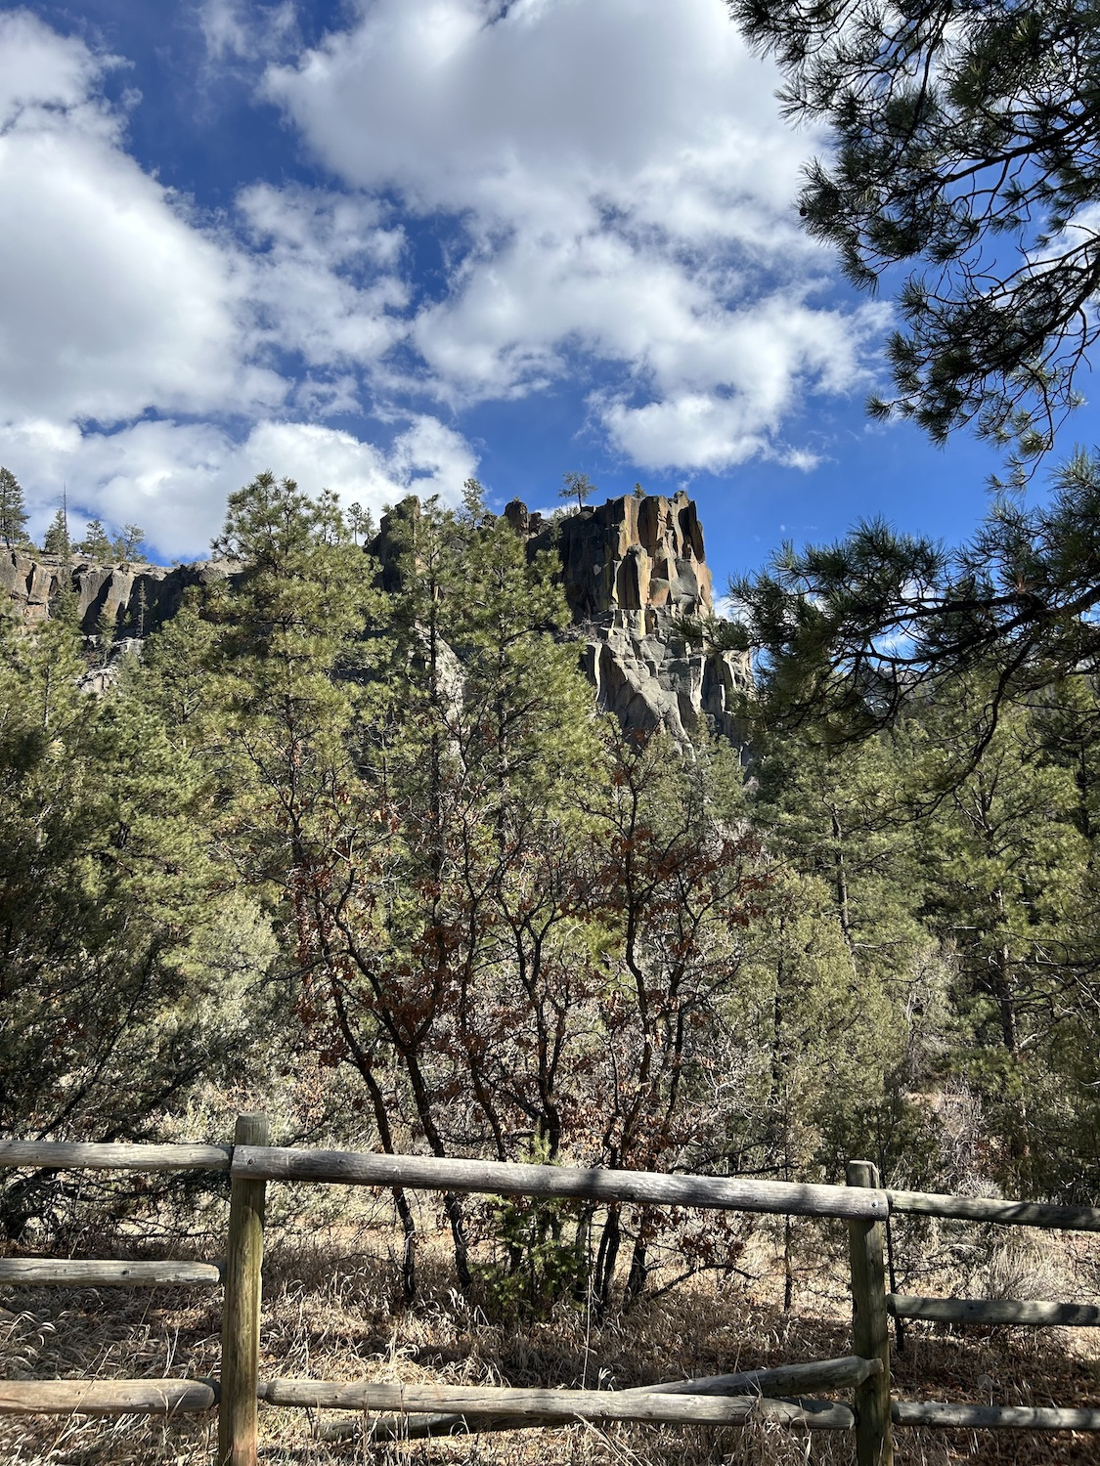
Battleship Rock
New Mexico
Battleship Rock is a geological feature along a windy little highway in New Mexico, proudly taking up the skyline. An enticing parking lot invites the car in with a perfect view framing the rock. A great spot for families to come and picnic, Battleship Rock is a perfect place for a family day trip. Yet, the beauty quickly fades, the human impact comes into focus. The trail from the parking lot is littered with crushed beer cans, old cigarettes, food wrappers, and the land is marred by over-eager boots. Eighty-eight percent of westerns fear the loss of habitat for fish and wildlife, yet turn a blind eye when visiting national parks. The responsibility of preservation seems to shift from ‘we need to preserve’ to ‘somebody else can pick that up’. Battleship Rock was formed millennia ago and will stand proud for many years to come, unless we don’t stop.

Slide 35
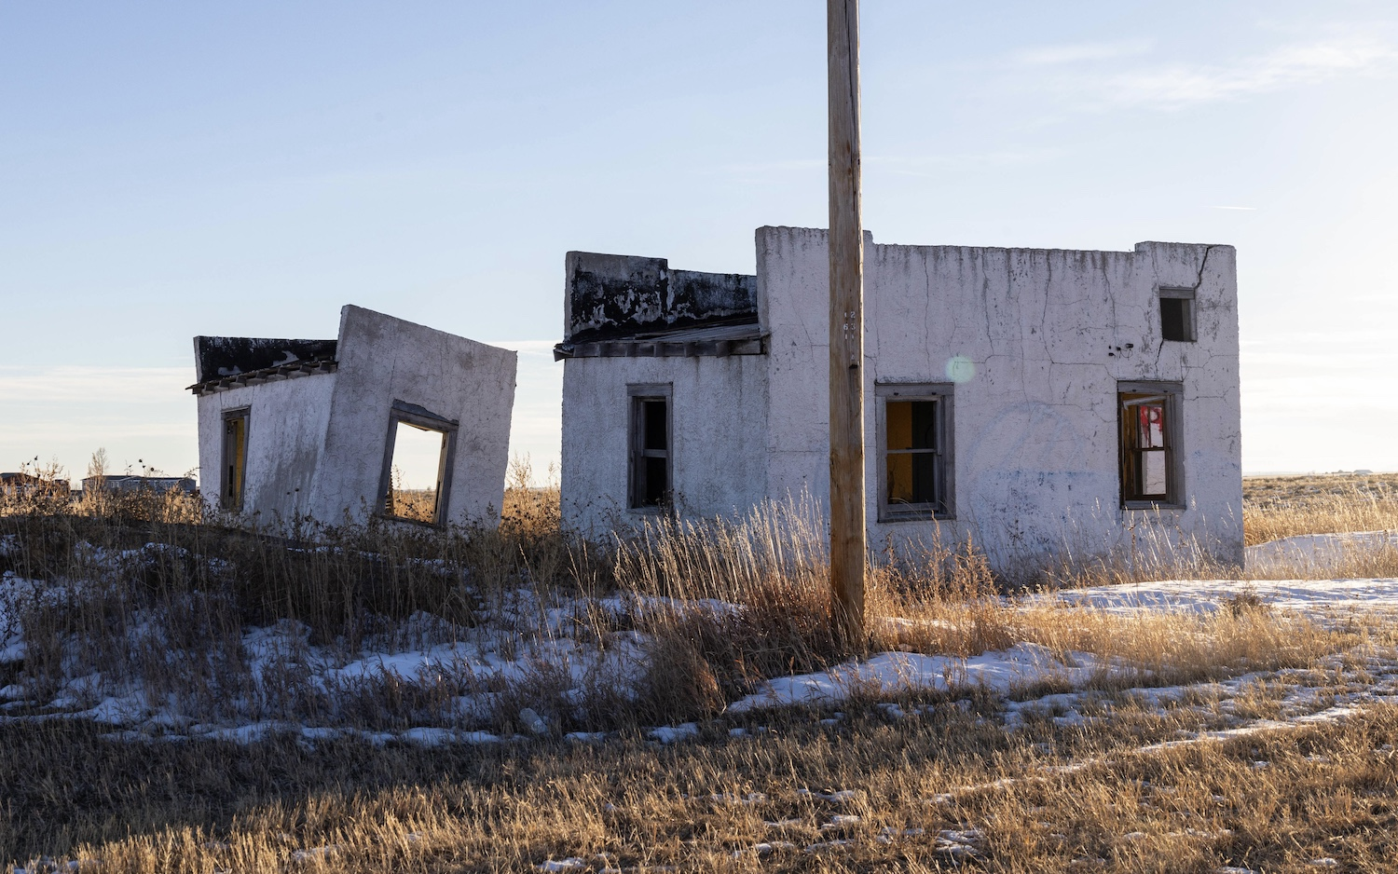
Unsustainable Architecture
Eastern Colorado
This photo was taken in the plains of Eastern Colorado. It invites viewers to contemplate the fleeting nature of landscapes and structures in the region. Nestled within the often-overlooked expanse of arid and dry fields, the solitary building depicted stands as a testament to both resilience and impermanence. The structure pictured is made from cement that has outlived its residence and its surroundings. As Colorado’s infrastructure continues to rapidly expand, we must think in terms of building and consuming sustainably. Beyond mere conservation, this image compels us to consider responsible creation, thoughtful building practices, and harmonious coexistence with our environment.

Slide 36
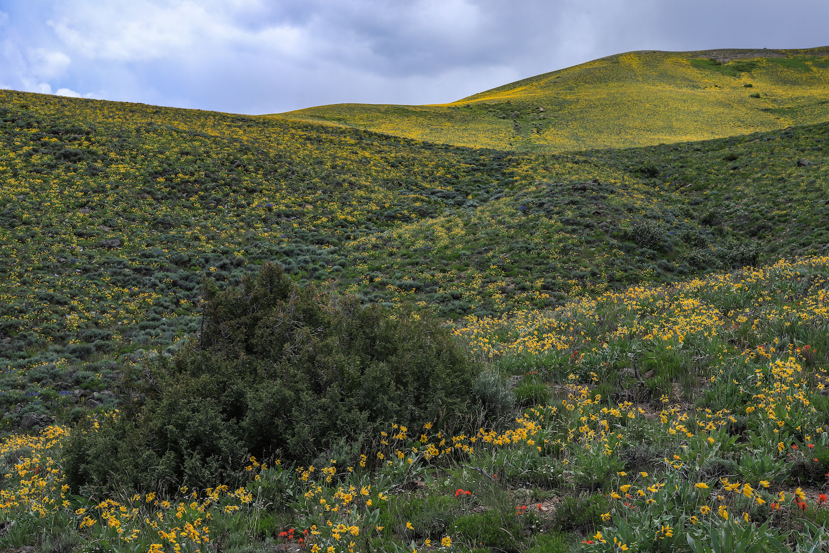
Super Bloom
Rocky Mountains
Winter snowpack is the Rocky Mountain Region’s largest water reservoir. Each winter’s snowfall determines the following summer’s water availability, wildfire danger – and wildflower season. The super bloom, and summer, seen in this photograph followed an exceptional winter. With the increasing uncertainty of annual snowfall and decreasing likelihood of exceptional winters, super blooms like this may exist only in photographs.

Slide 37
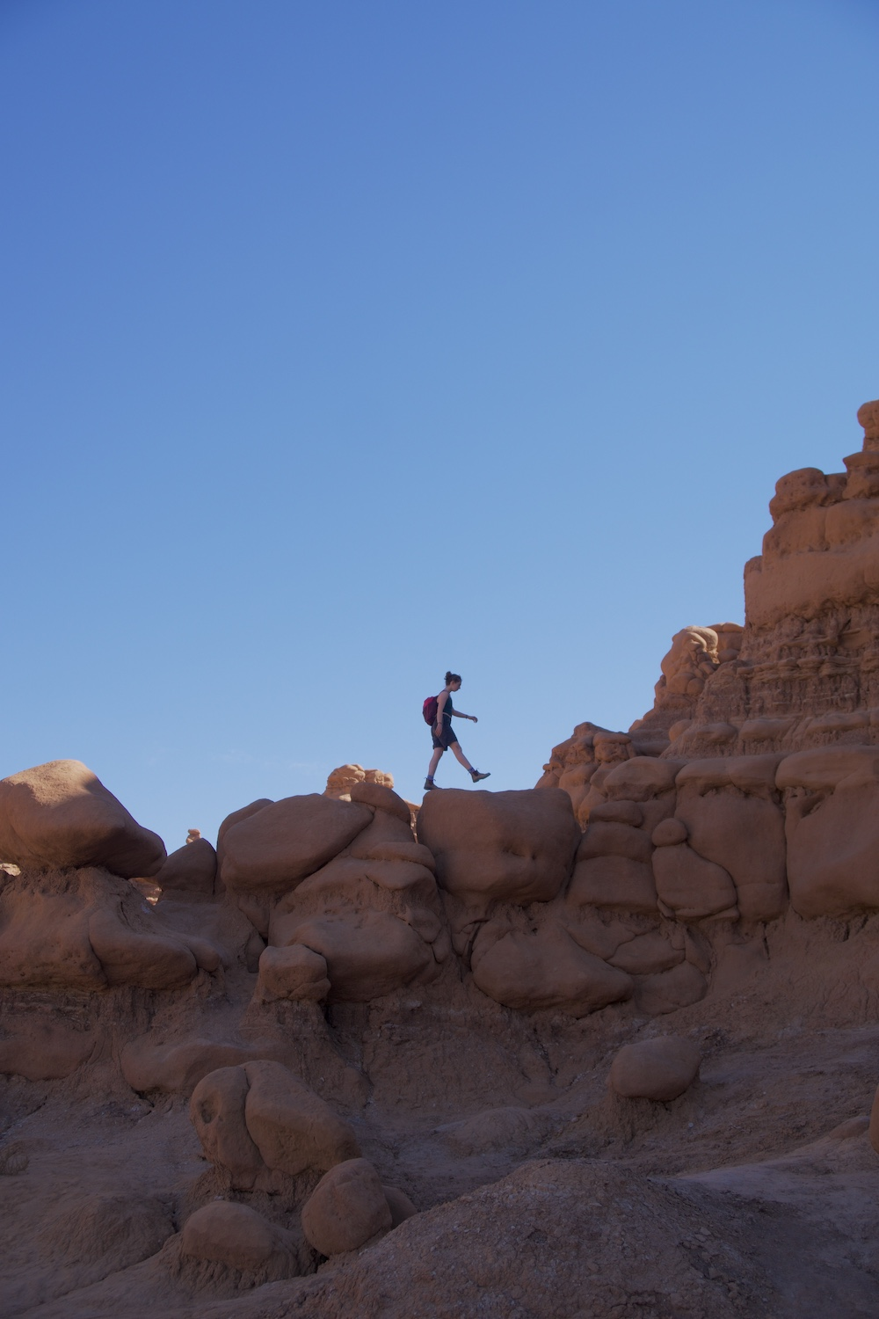
Leave No Trace
Goblin State Park, Utah
For this image my intention is to bring awareness how we step into the wild. As a kid my parents and teachers preached the values of "leave no trace:" important standards to live by in the outdoors. In this image the figure is walking along a dramatic rock formation that took millions of years to form. This image asks: should we as outdoor enthusiasts be able to explore and leave footprints on these delicate and extraordinary art formations? Where is the line between exploring nature and preserving it?

Slide 38
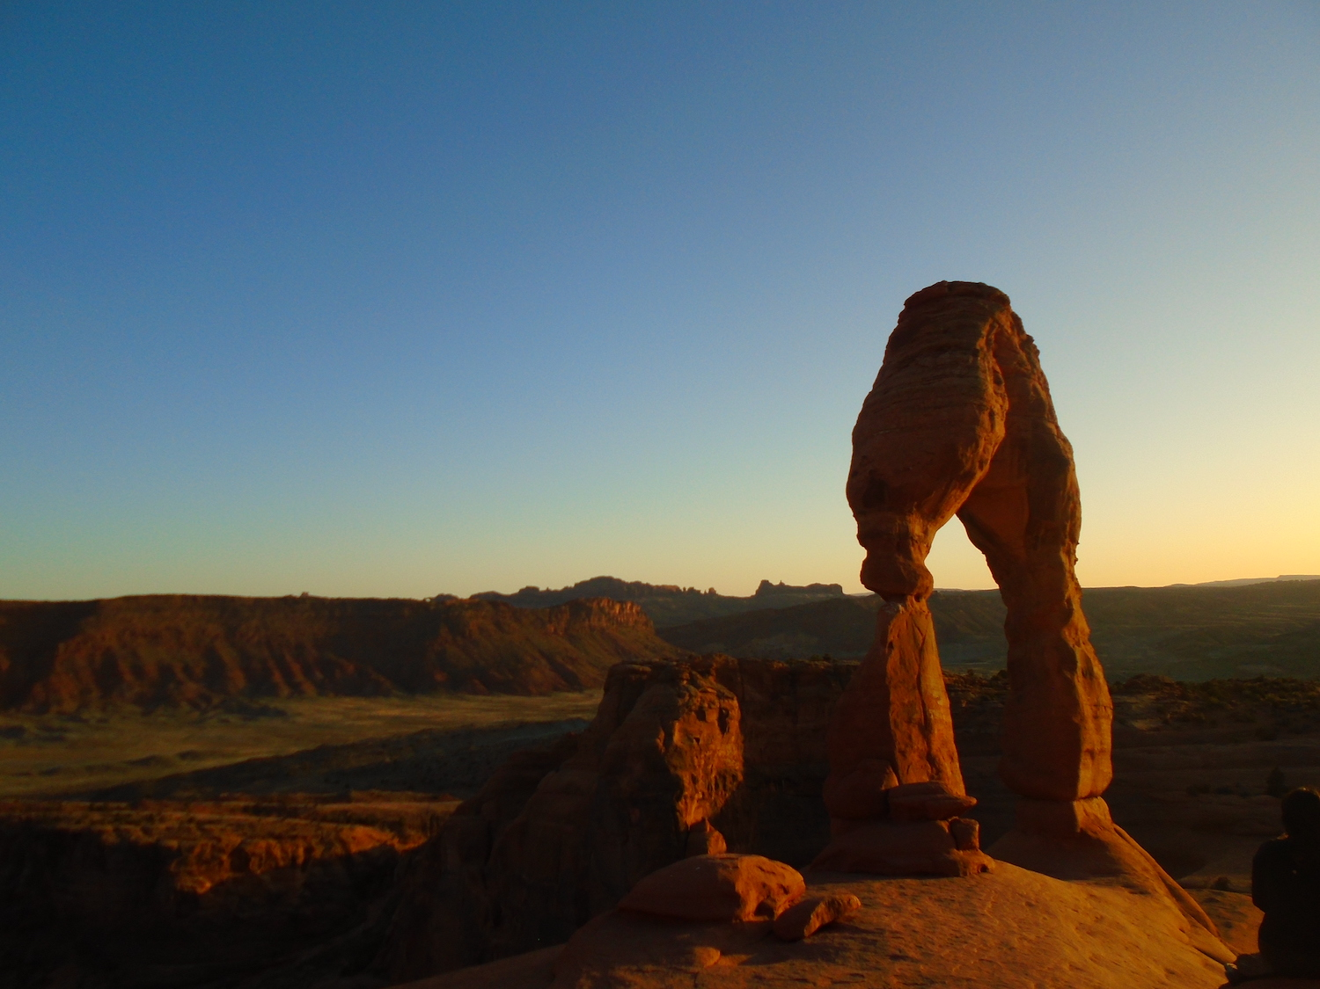
Delicate Arch
Arches National Park, Utah
The sheer beauty of the Delicate Arch in Arches National Park makes it easy to see why so many care about the preservation of public lands through national parks, monuments, and reserves. But whose land was it in the first place? To me, the delicate nature of the arches In the park represent the balance between preserving land and recognizing those who were there first. The land is beautiful, but at what cost?

